Slide 1

One Vendor: One Service Order : One Project

Slide 2
Agenda
1. Business Objective
2. Scenario 1 - Quantity amendment for an existing line item in the service PO
4. Scenario 3 – Additional Quantity with a new rate for an existing scope (line item) in the service PO, which has other active line items.
5. Scenario 4 – New Scope to be awarded to the vendor / contractor after quantities in existing Service PO are delivered.
3. Scenario 2 – Rate amendment for an existing line item in the service PO

Slide 3
Business Objective
A Single Service PO should exist for a Vendor / Contractor for a particular Project
Ease in tracking the scope and value of work awarded to the Vendor / Contractor.
Standardization of Payment & Commercial Terms of the Vendor / Contractor.
Elimination of efforts to reconcile the work done against total scope awarded to the Vendor / Contractor.

Slide 4
Scenario 1 - Quantity amendment for an existing line item in the service PO
Quantity amendment for an existing line item in the service PO.
As and when the business team decides to increase the scope of work (with the same rate) a new line item with the needed quantity shall be added in the Service PO (Tcode –ME22N) after a Service PR is raised (Tcode –ME51N).

Slide 5
Scenario 2 – Rate amendment for an existing line item in the service PO
Rate amendment for an existing line item in the service PO.
The rate for a service rendered may require a change during the course of the work. In this case, a new line item shall be added in the Service PO (Tcode – ME22N) for services with the needed quantity and new rate. Care should be taken to ensure that the quantity existing in the Service PO (with Old Rate) should be descoped, before saving the Service PO.

Slide 6
Scenario 3 – Additional Quantity with a new rate for an existing scope (line item) in the service PO, which has other active line items.
Additional Quantity with a new rate for an existing scope (line item) in the service PO, which has other active line items.
When the vendor/contractor has executed the service PO quantity for an existing line item and there is a need to add additional quantity with a new rate, a new line item shall be created with the quantity (and revised rate) in the Service PO (T Code – ME22N), after a Service PR (Tcode – ME51N) is raised in system for the new quantity.

Slide 7
Scenario 4 – New Scope to be awarded to the vendor / contractor after quantities in existing Service PO are delivered.
New Scope to be awarded to the vendor / contractor after quantities in existing Service PO are delivered.
When the vendor/contractor has executed the service PO quantities and there is a need to award new work to the vendor / contractor, a new Service PO shall be created (T code – ME21N), after a Service PR is raised (Tcode – ME51N).

Slide 8
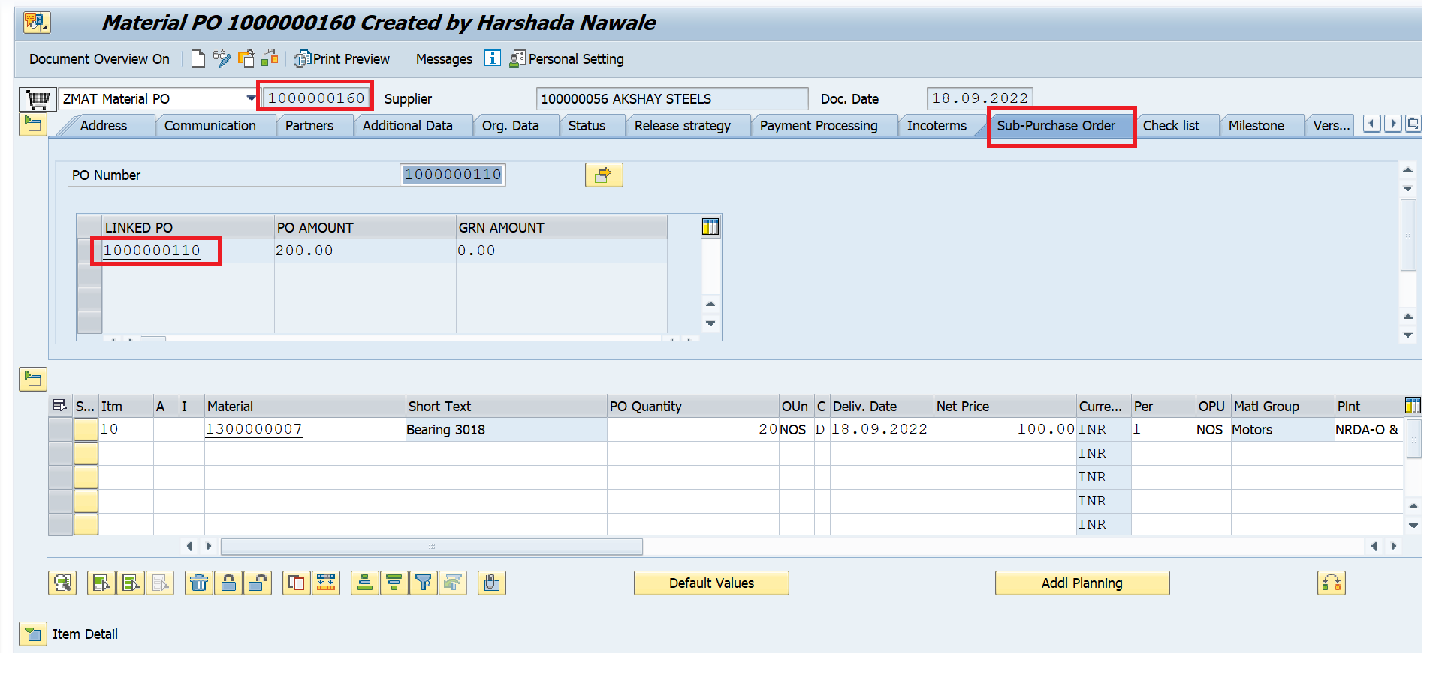
Functionality for linkage Between PO’s

Slide 9
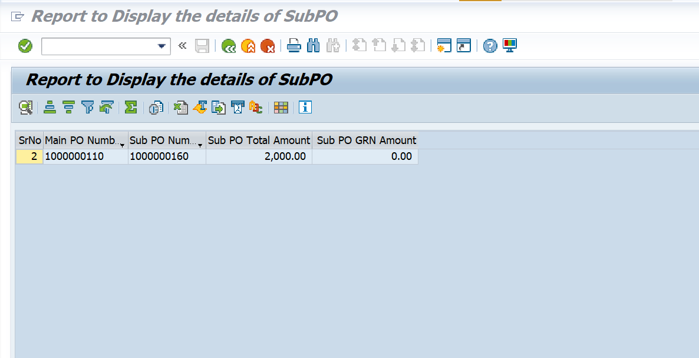
Report to Display the details of Linkage between PO’s
T code – ZMM034

Slide 10
Thank You !

